Slide 1
Empy node
1-edge
X
X
X
a
b
a
X
Y
Z
2-edge
X
X
a
a
X
X
b
a
Y
Z
3-edge
X
a
X
b
a
Y
Z

Slide 2
Empy node
0-edge
1-edge
2-edge
3-edge
X
X
X
a
a
a
X
X
X
b
X
a
b
Y
X
Y
Z
b
Y
X
Y
a
X
X
a
a
Z
Z
Z
X
b
a
Y
Z

Slide 3
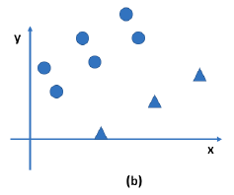
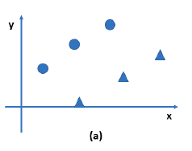

Slide 4
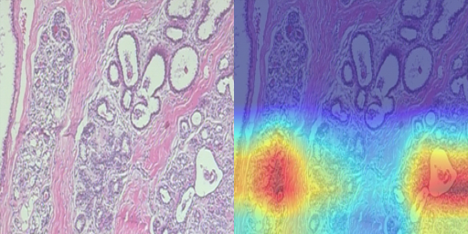
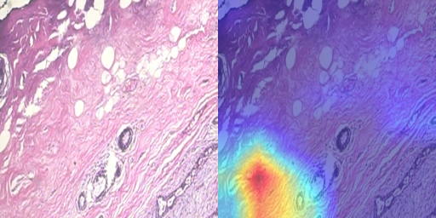
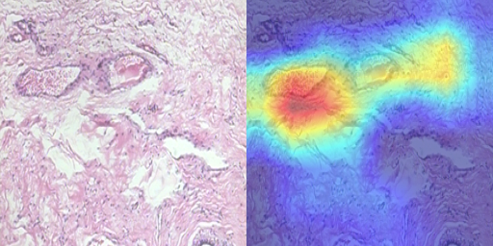
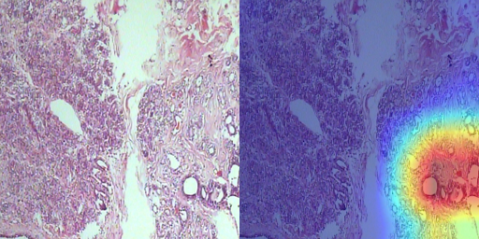

Slide 5
Layer-0
Layer-0
Layer-0
Layer-0
Layer-0
Layer-0
Layer-0
Layer-0
a
a
a
a
a
a
Layer-1
a
Layer-1
Layer-2
Layer-2
b
b
b
b
b
b
b
c
c
c
c
c
c
c
a
a
a
a
a
a
a
a
a
a
a
a
a
a
d
d
d
d
d
d
d
f
f
f
f
f
f
f
a
a
a
a
a
a
f
a
f
f
f
f
f
f
c
c
c
c
c
c
c
d
d
d
d
d
d
d
e
e
e
e
e
e
e

Slide 6
Layer-0
a
Layer-1
b
d
f
Layer-2
a
c
a
f
a
c
d
e

Slide 7
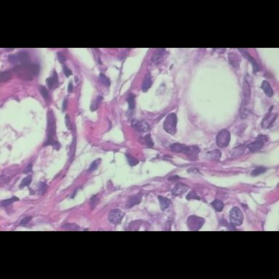
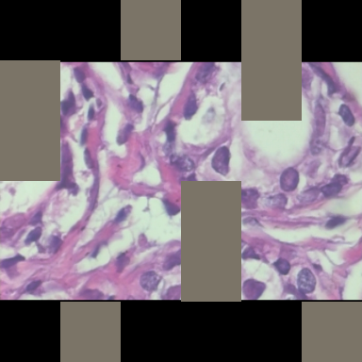
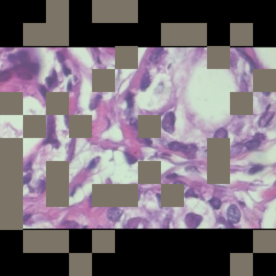
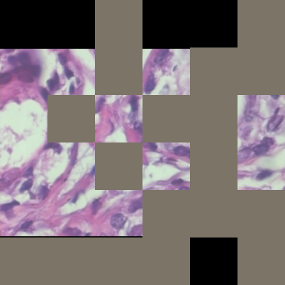
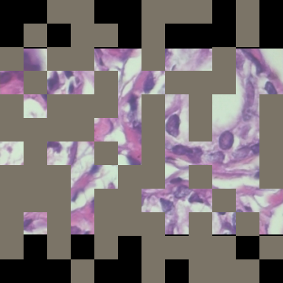
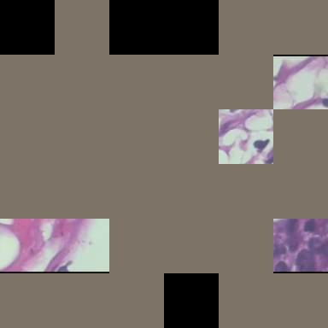
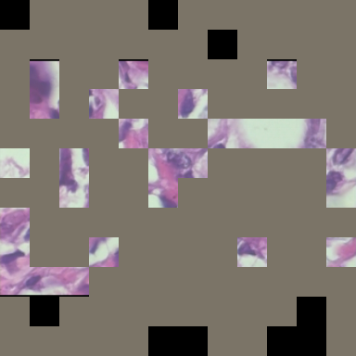
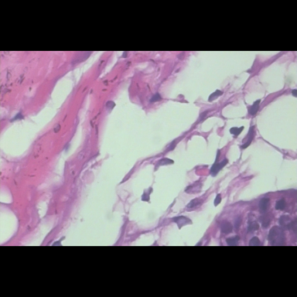
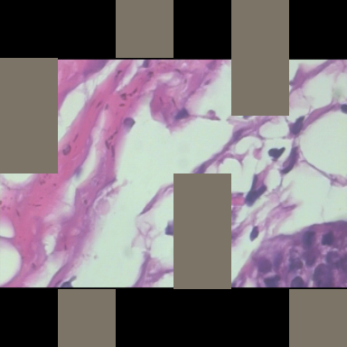
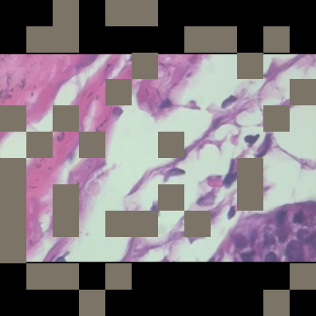
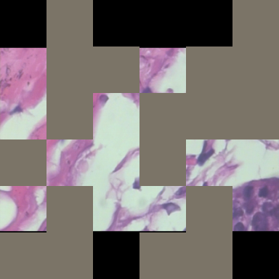
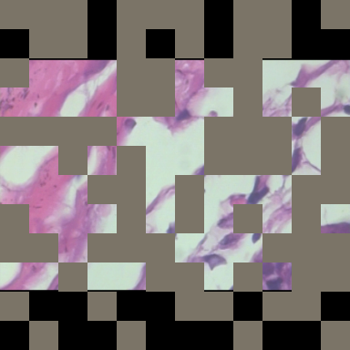
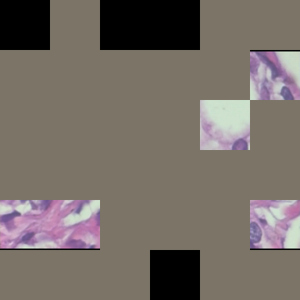
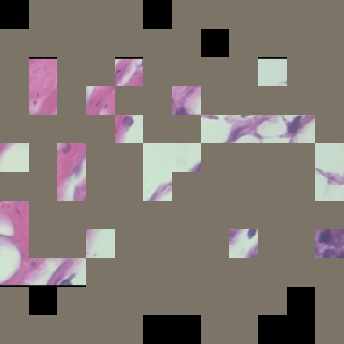
Raw
Patch size: 32
Mask ratio: 0.25
Patch size: 64
Mask ratio: 0.25
Patch size: 32
Mask ratio: 0.5
Patch size: 64
Mask ratio: 0.5
Patch size: 32
Mask ratio: 0.75
Patch size: 64
Mask ratio: 0.75

Slide 8
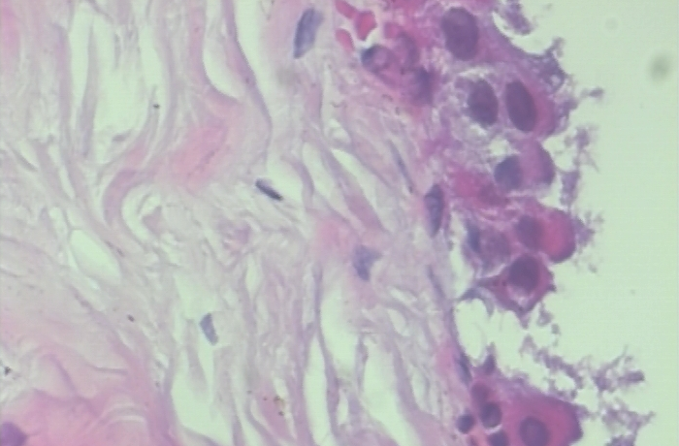
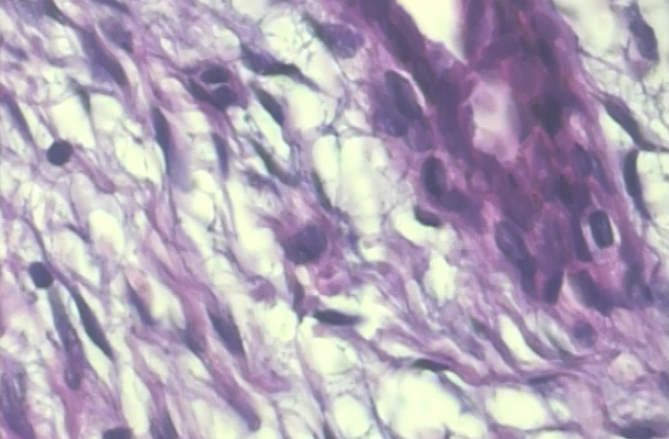
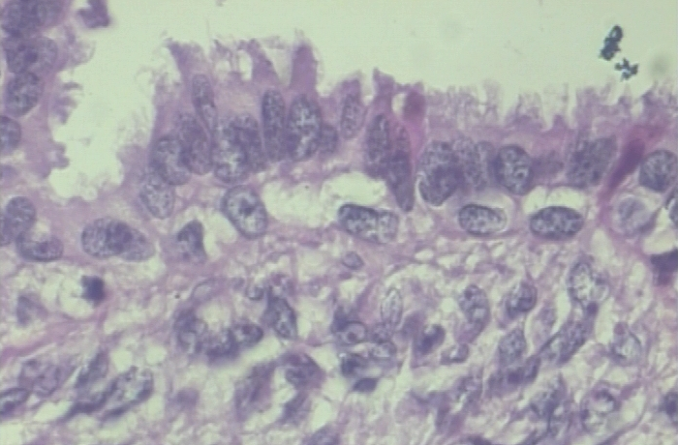
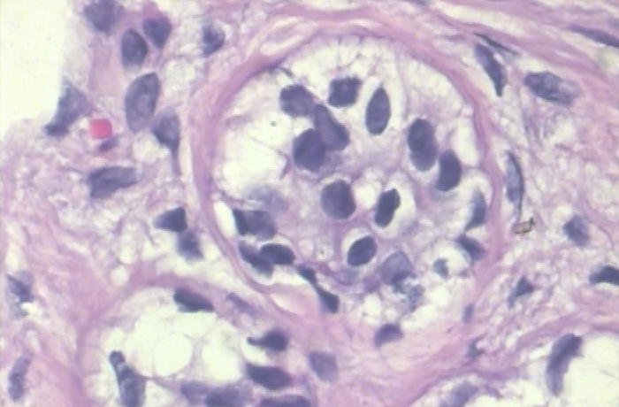
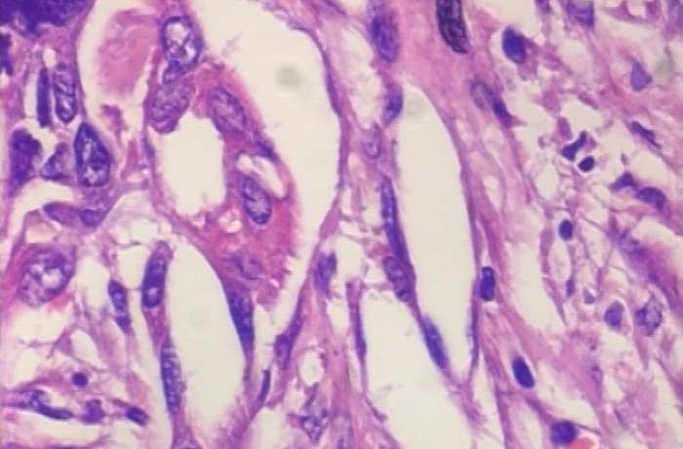
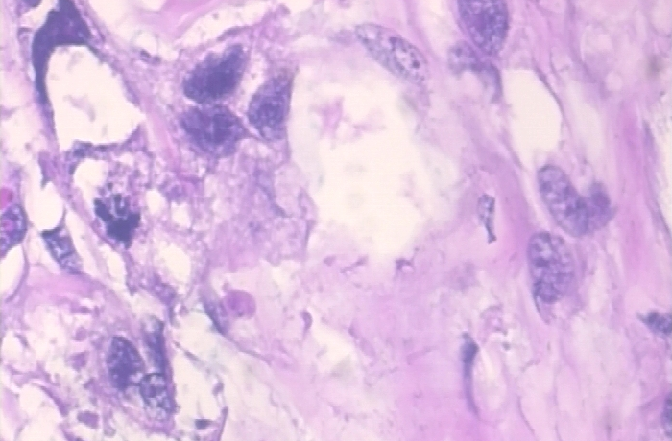
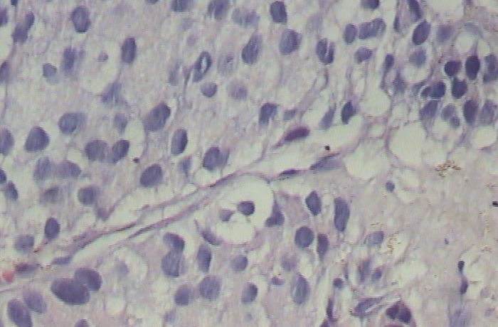
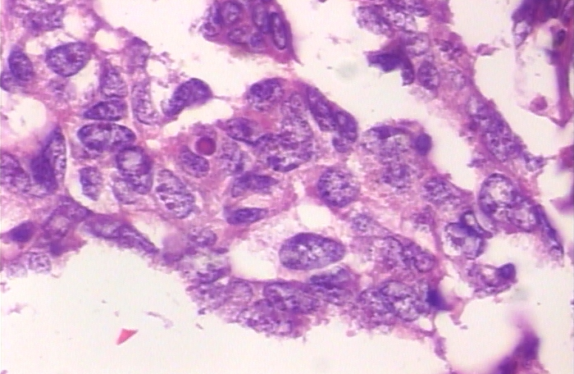
Benign
Adenosis
Fibroadenoma
Phyllodes tumor
Tubular adenoma
Malignant
Ductal carcinoma
Lobular carcinoma
Mucinous carcinoma
Papillary carcinoma

Slide 10
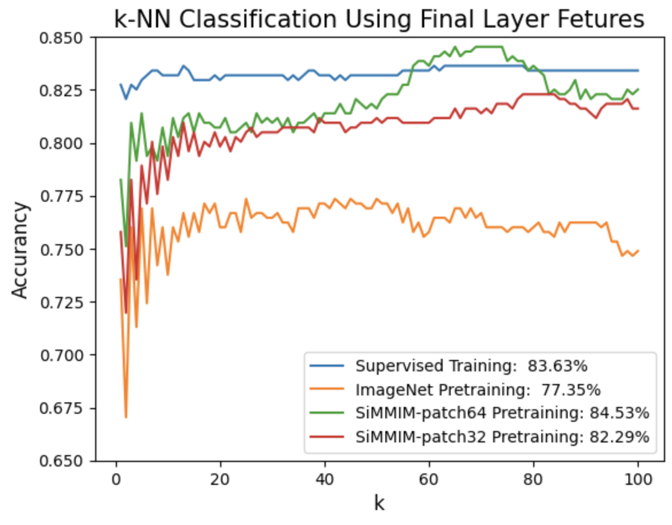

Slide 11
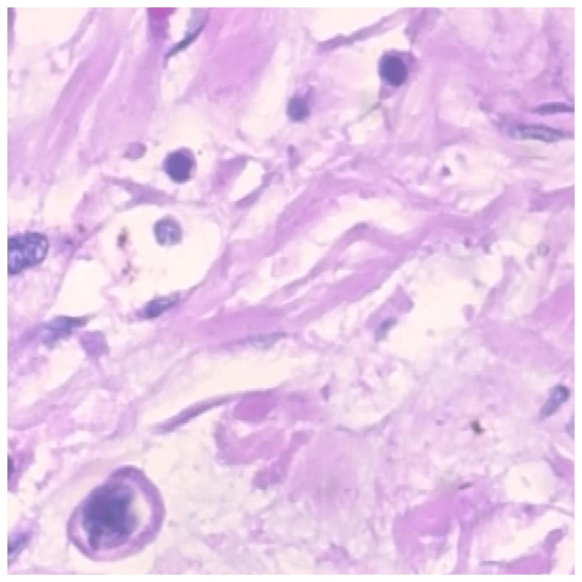
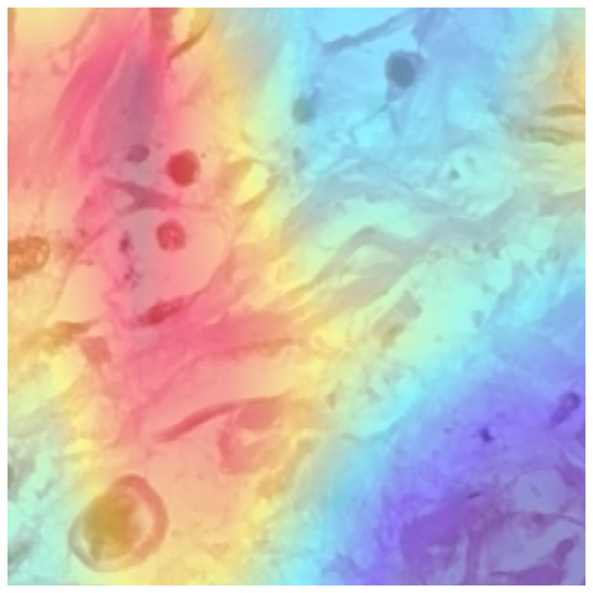
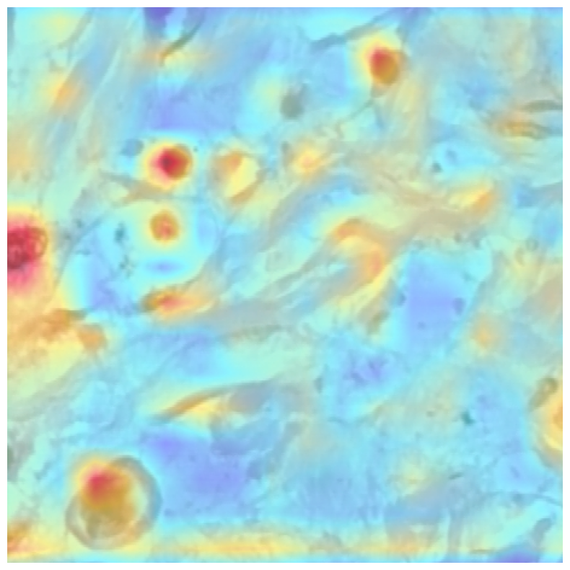
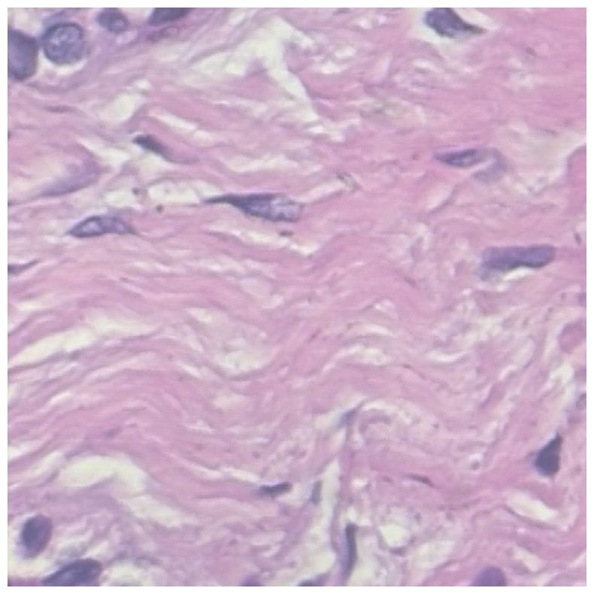
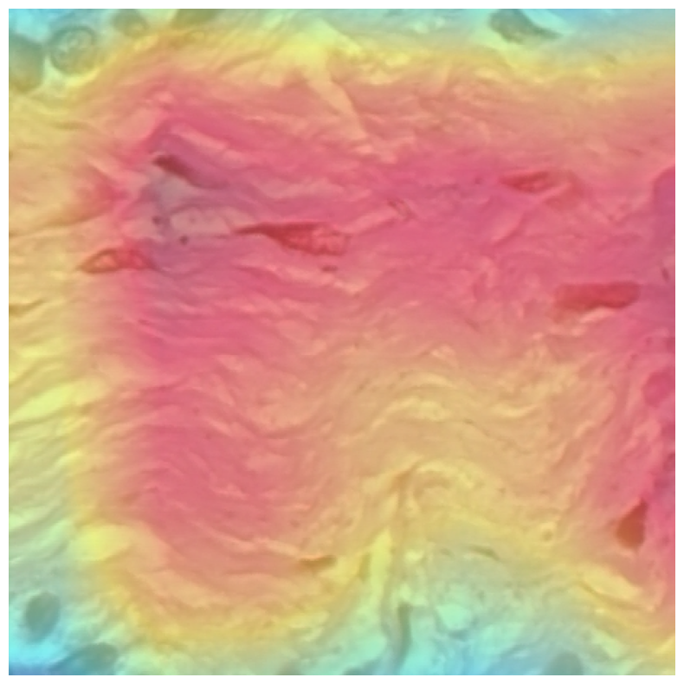
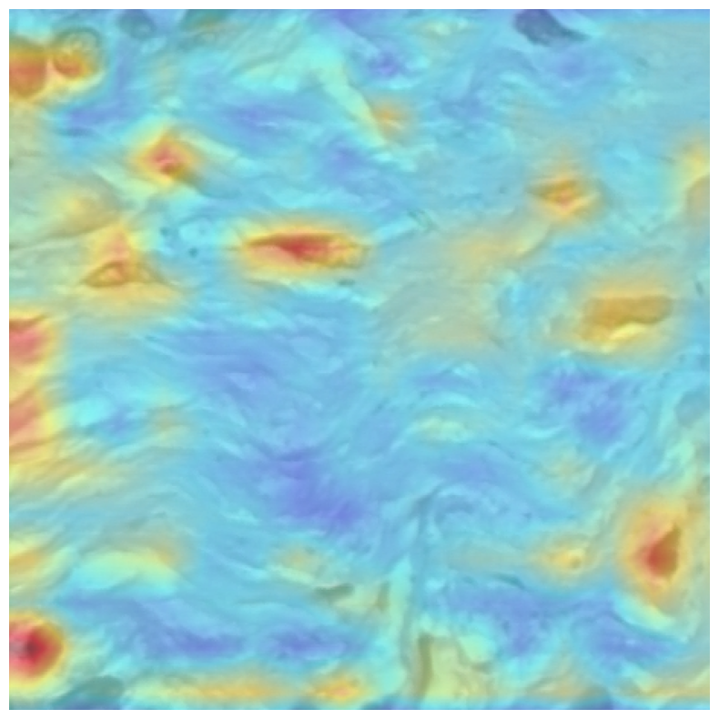
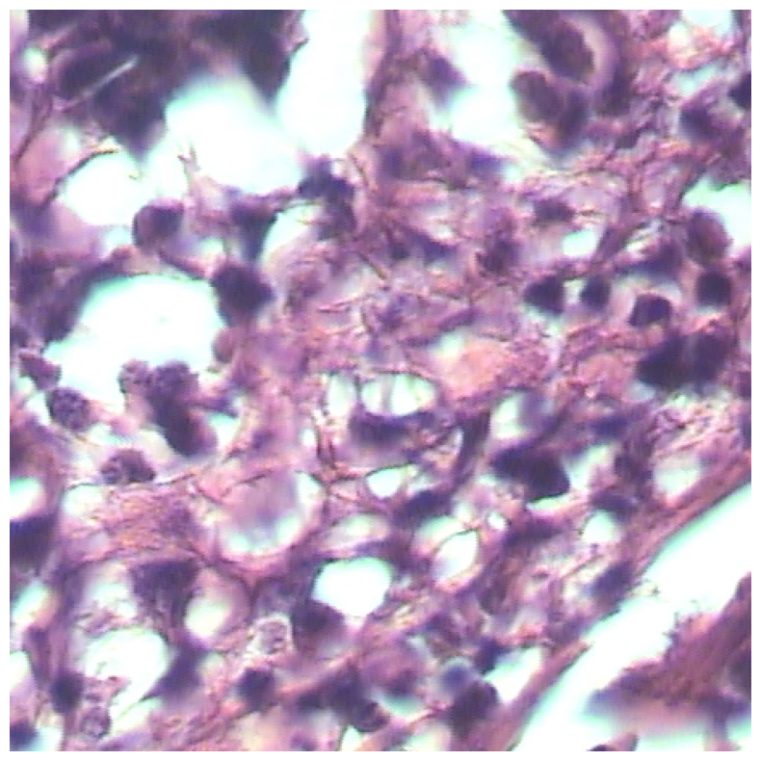
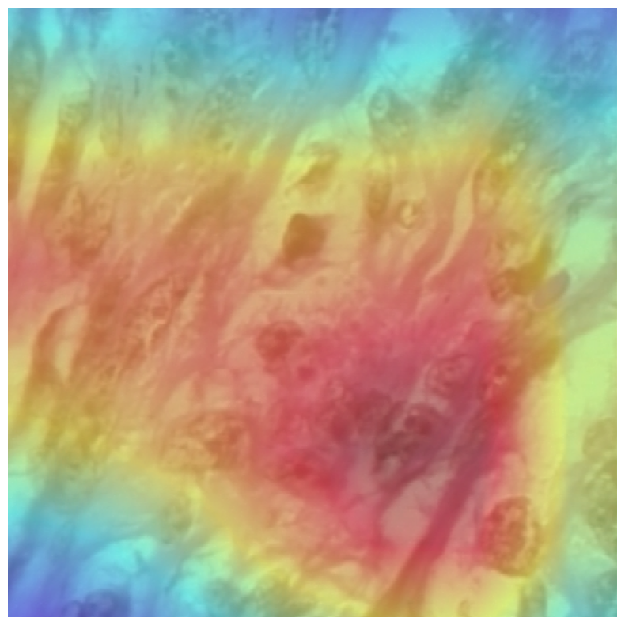
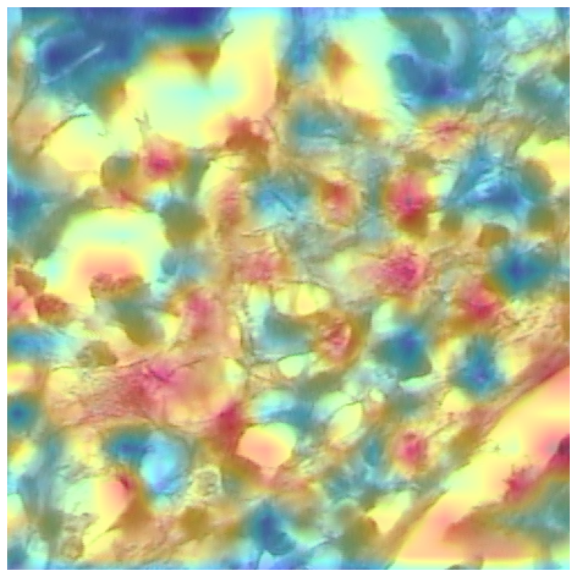
Multi-head Attention
Raw
Grad-CAM

